Slide 1


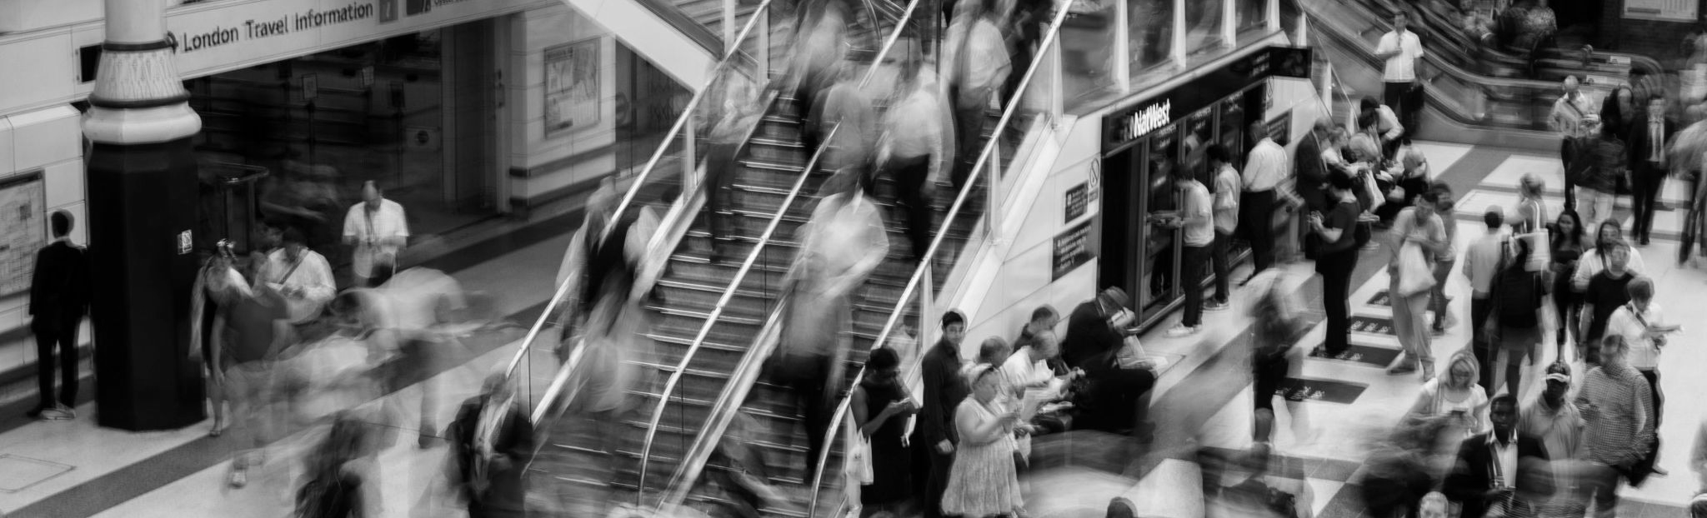
IYKRA
Data Fellowship Program
Automating Customer Lifetime Value Prediction with Machine Learning
By Group 2
31 May 2024
Proprietary of IYKRA - Data Fellowship

Slide 2

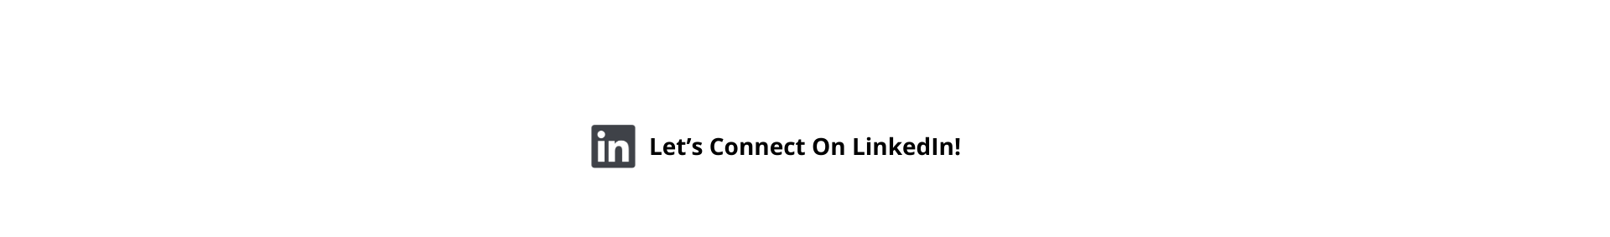
Members
Proprietary of IYKRA - Data Fellowship

Slide 3
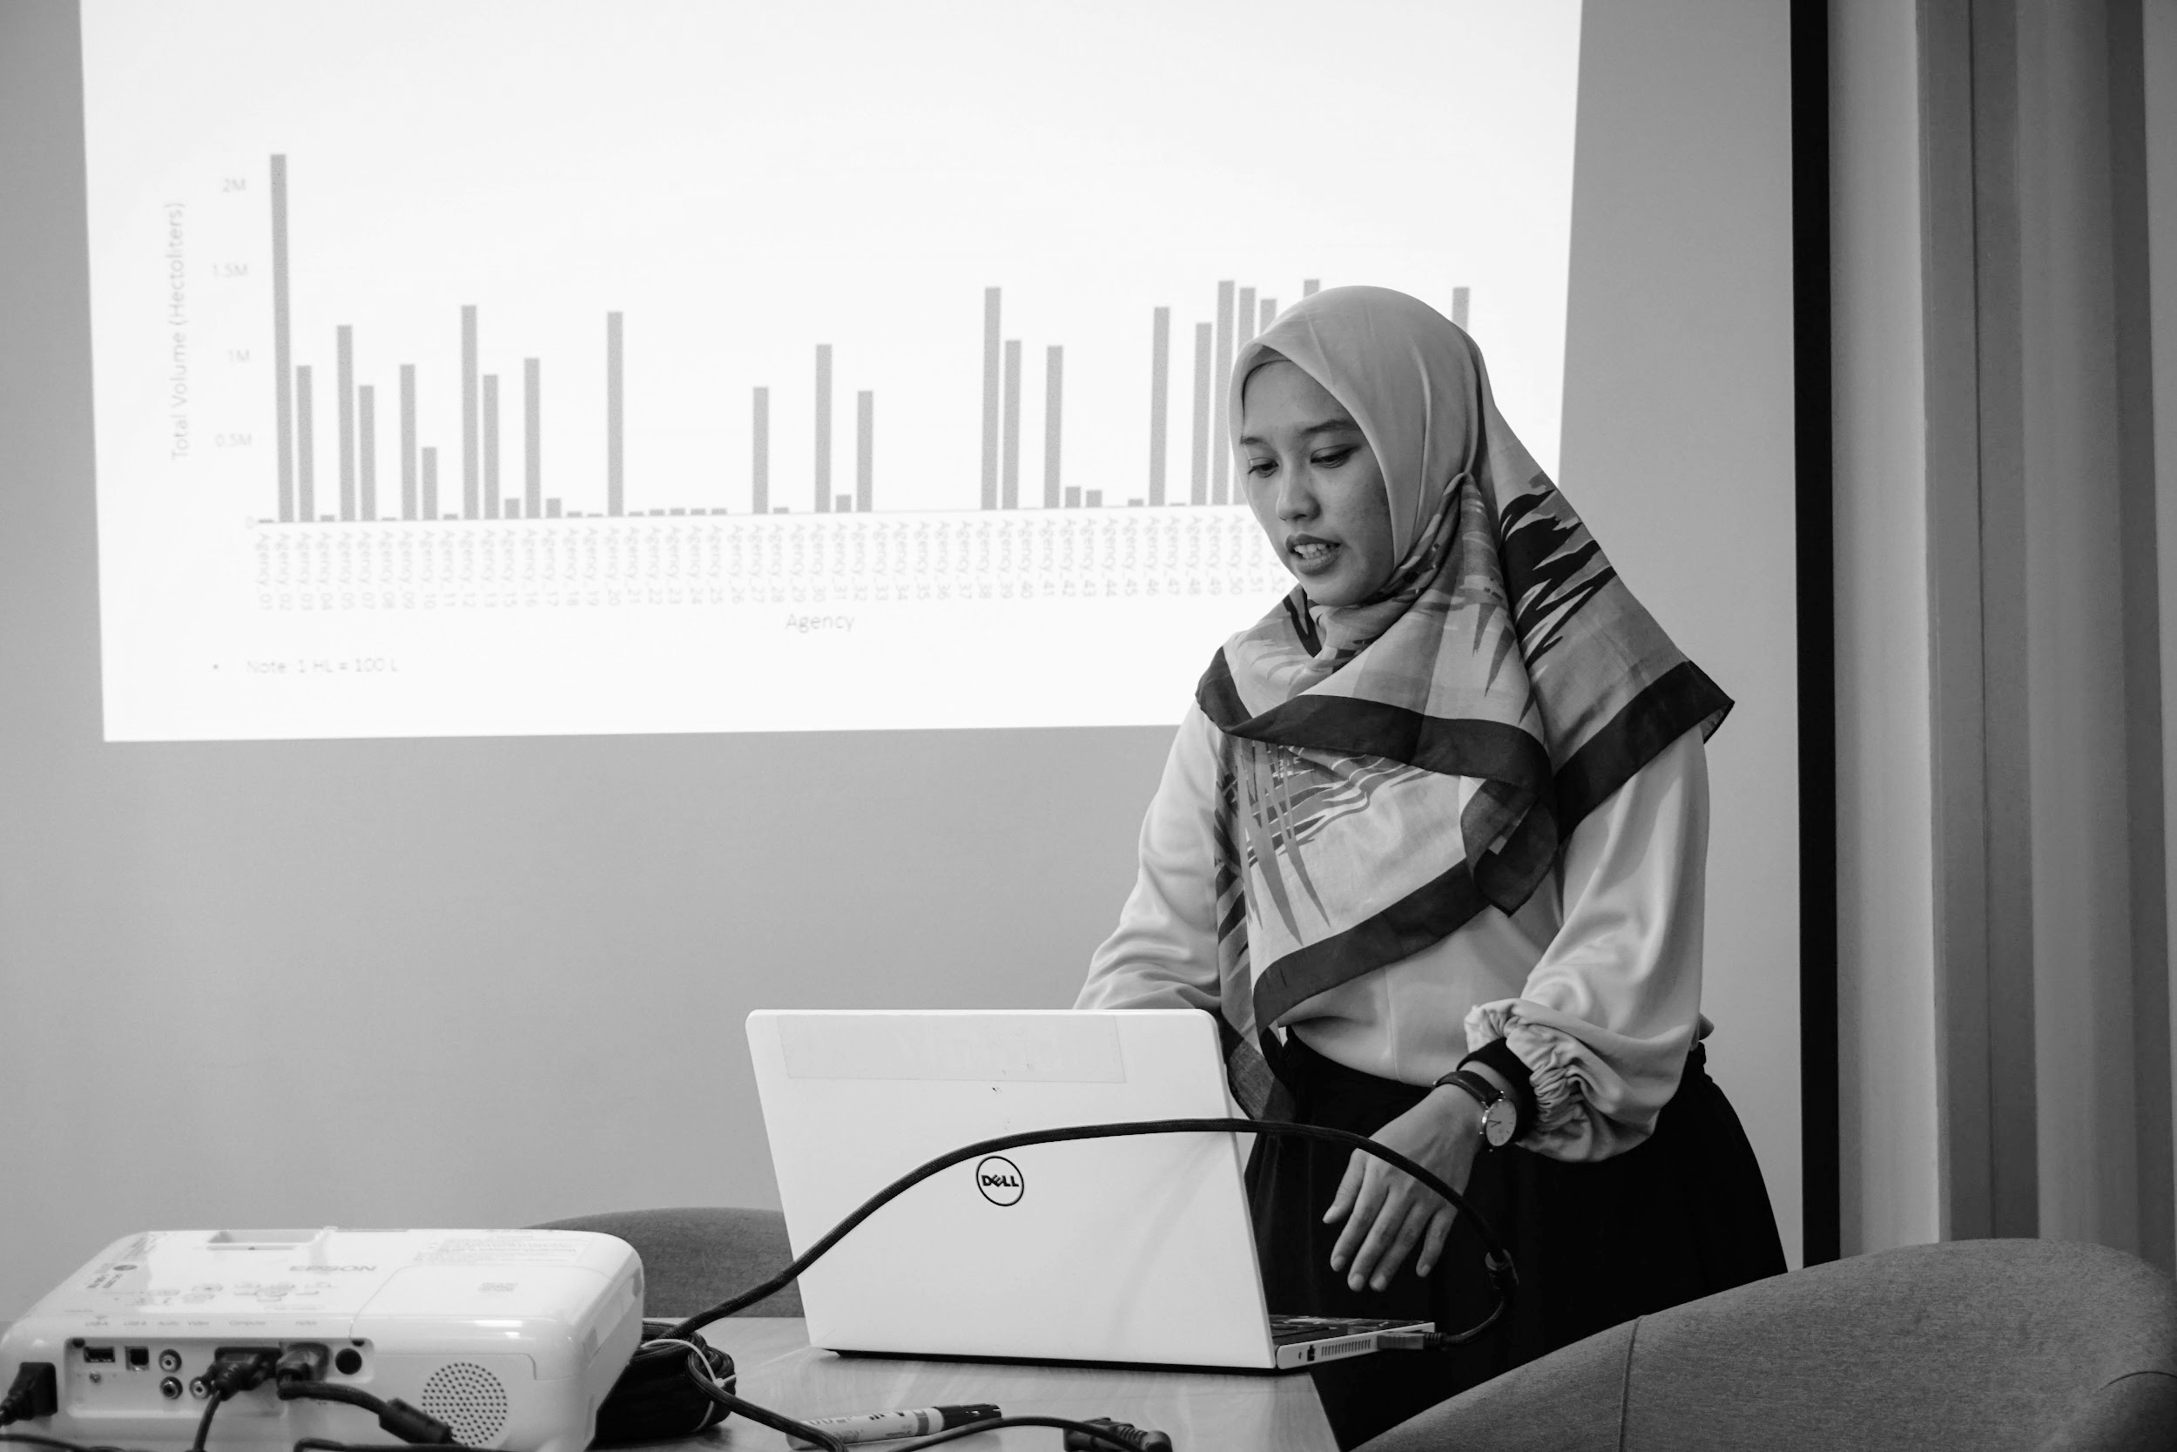


Table of Content
Project Objective
Proposed Architecture
Data Ingestion
Data Quality
Analytics & Reporting
Conclusion and Improvement
Reproducibility
Proprietary of IYKRA - Data Fellowship

Slide 4
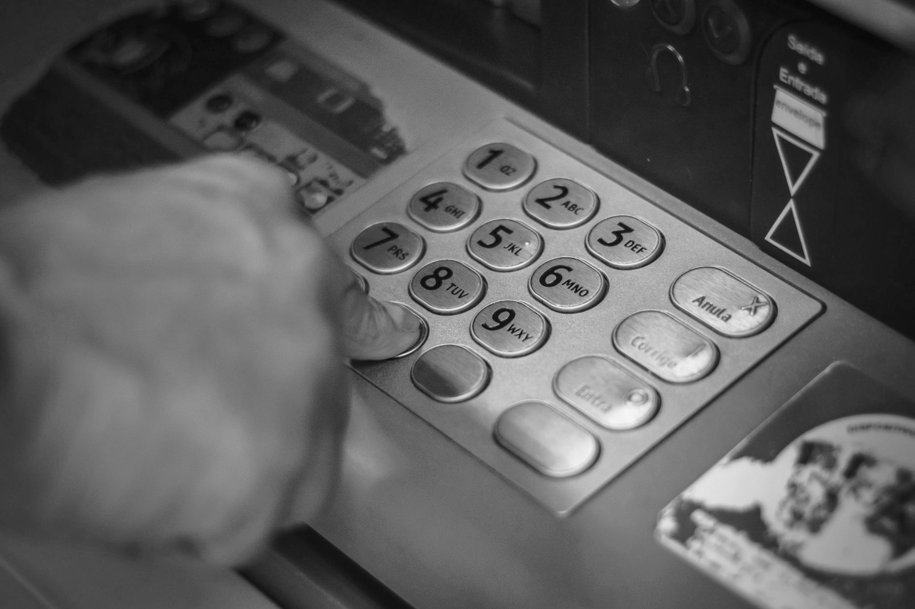

Project Objective

Slide 5
Project Objective
Business Understanding
There’s a Pareto principle that comes from an Italian economist saying that for many outcomes, roughly 80% of consequences comes from 20% of causes. Similarly, 80% of companies business comes from 20% customers. That’s why companies need to identify those top-valued customers and maintain the relationship with them to ensure continues revenue. In order to maintain a long-term relationship with customers, company need to schedule loyalty schemes such as the discount, offers, coupons, bonus point, gifts, etc.
Customer Lifetime Value (CLTV) helps business identify the high-potential customers. By analyzing past customer behaviour and revenue, CLTV can predicts the total value a customer can bring over time. This allow companies to prioritize efforts toward attracting and retaining customers with the greatest future profit potential.
Proprietary of IYKRA - Data Fellowship

Slide 6
Project Objective
Problem Statement
Goal
The current customer management approach at the bank lacks a systematic and data-driven method to assess customer lifetime value (CLTV). This results in:
Inefficient resource allocation: Marketing efforts and resources may not be directed towards the most valuable customers.
Limited customer segmentation: Existing segmentation strategies might not fully capture the potential future value of different customer groups.
Reactive approach to customer churn: The bank may not be proactively identifying and addressing the needs of customers at risk of churning.
Develop and implement an automated machine learning system for predicting customer lifetime value (CLV) at the bank from a historical transaction data.
Proprietary of IYKRA - Data Fellowship

Slide 7
Project Objective
Objectives
Predict Customer Lifetime Value (CLV): Develop a machine learning model that can predict the future value a customer will bring to the bank over their entire relationship.
Automate the Prediction Process: Create an end-to-end automated pipeline that handles data collection, preprocessing, model training, and prediction.
Proprietary of IYKRA - Data Fellowship

Slide 8
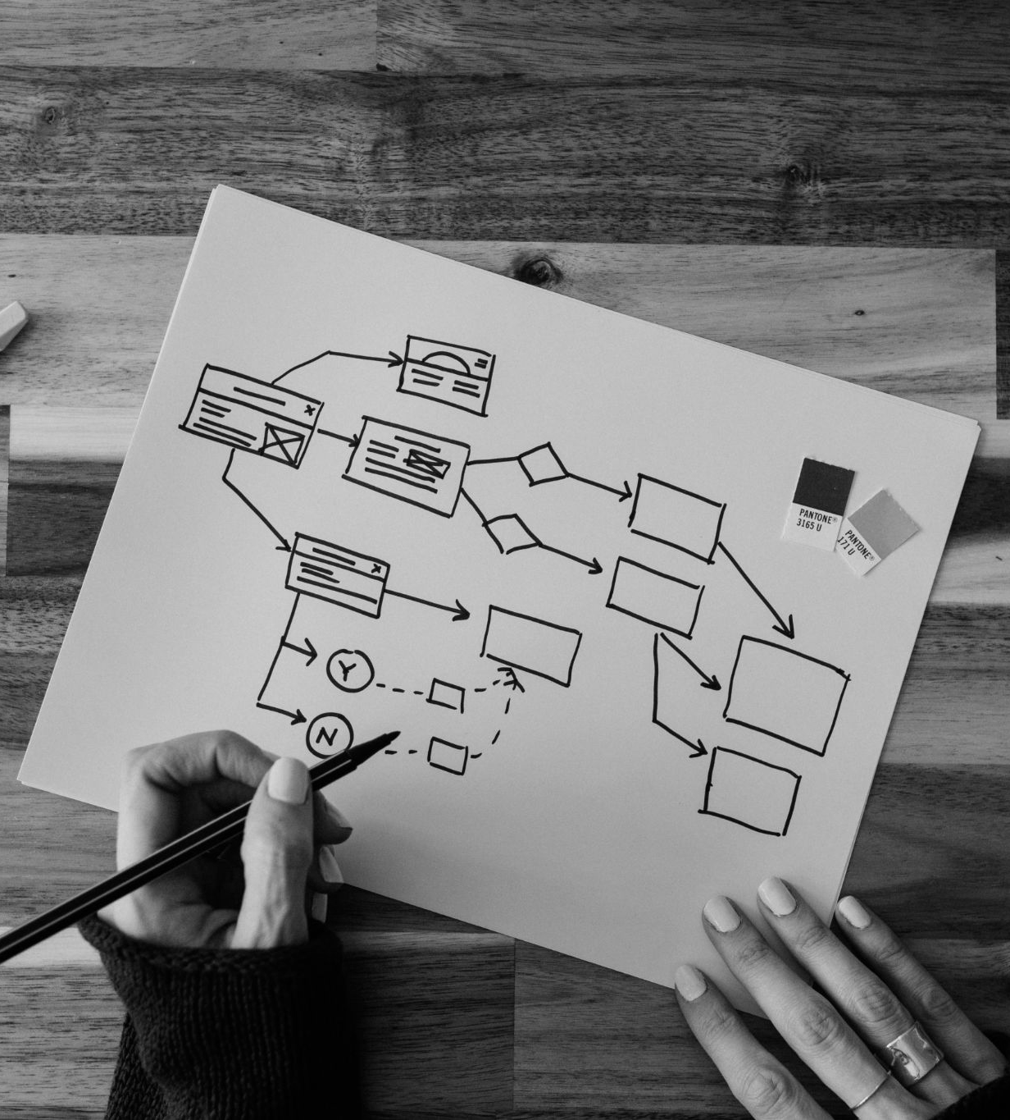
Proposed Architecture

Slide 9
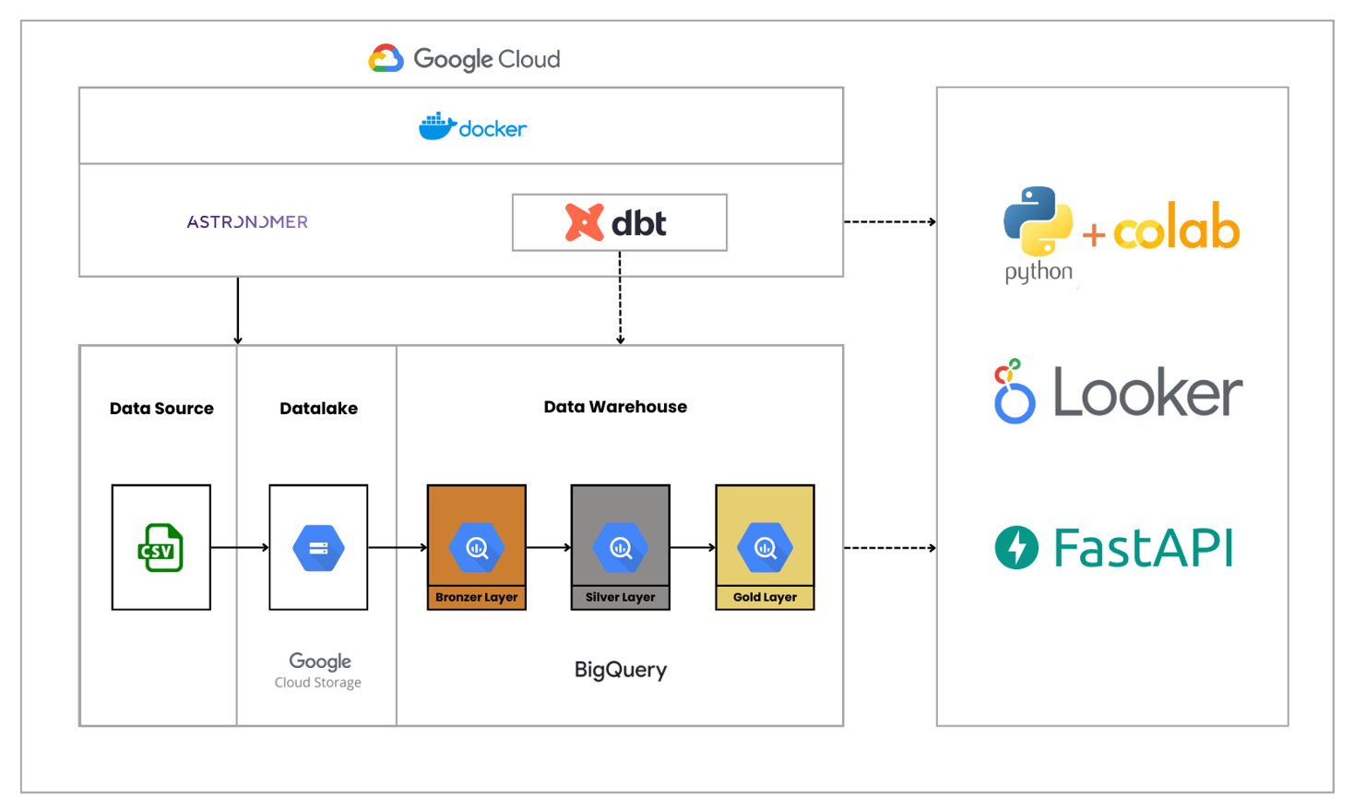
Proposed Architecture
Architecture Design (Full Stack)
Proprietary of IYKRA - Data Fellowship

Slide 10
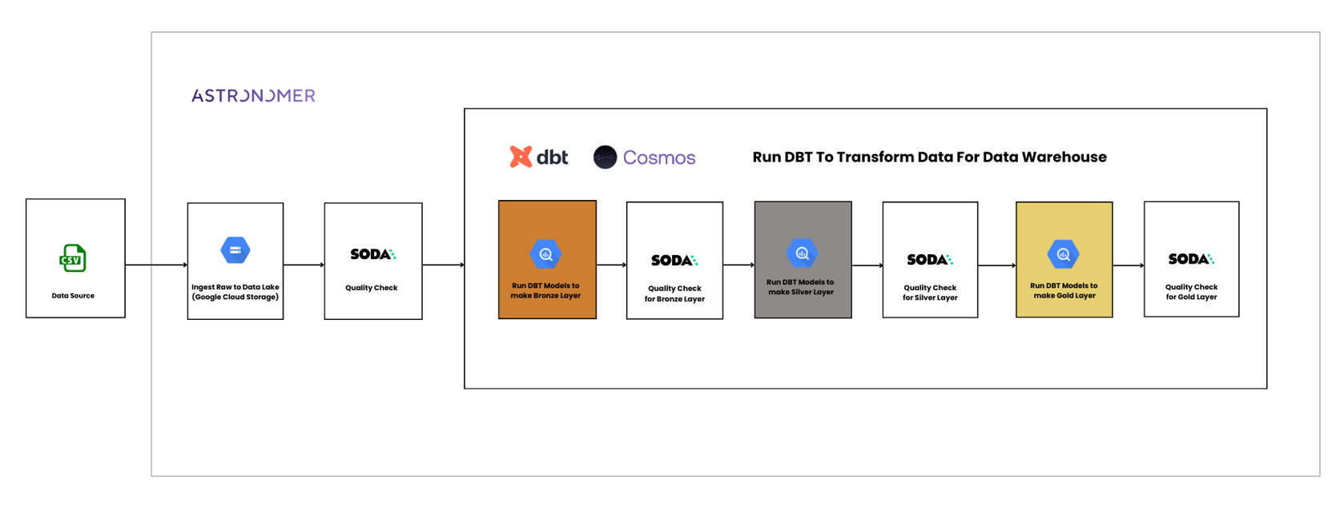
Proposed Architecture
Architecture Design (Data Pipeline)
Proprietary of IYKRA - Data Fellowship

Slide 11
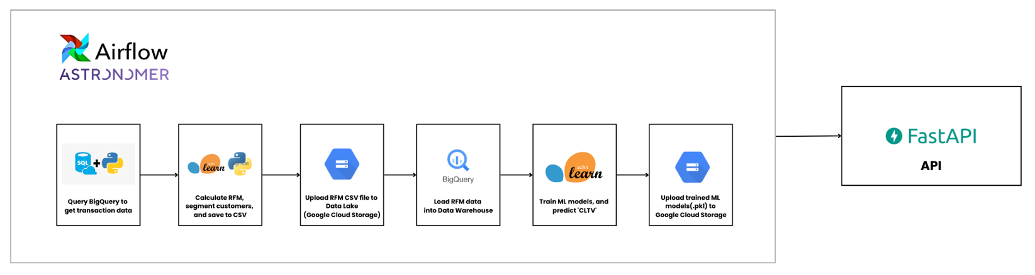
Proposed Architecture
Architecture Design (Machine Learning Pipeline)
Proprietary of IYKRA - Data Fellowship

Slide 12
Proposed Architecture
Deployment (Astro Deployment)
Proprietary of IYKRA - Data Fellowship

Slide 13
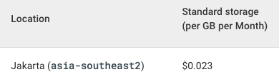
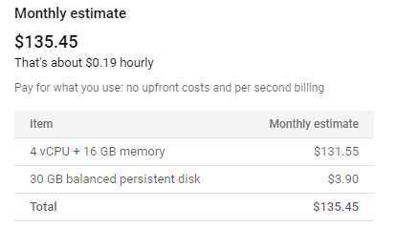
Proposed Architecture
Data Pipeline Cost
Free
Paid
GCP Cloud Storage
GCP VM Instance
Data Warehouse | BigQuery
Orchestrator | Astronomer
Transformation Workflow | dbt
Data Governance | Soda
Data Visualization | Looker Studio
Proprietary of IYKRA - Data Fellowship

Slide 14

Proposed Architecture
Data Source
Column | Explanation
InvoiceNo | a 6-digit integral number uniquely assigned to each transaction. If this code starts with letter 'c', it indicates a cancellation.
StockCode | a 5-digit integral number uniquely assigned to each distinct product
Description | product name
Quantity | the quantities of each product (item) per transaction
InvoiceDate | the day and time when each transaction was generated
UnitPrice | product price per unit
CustomerID | a 5-digit integral number uniquely assigned to each customer
Country | the name of the country where each customer resides
Online_Retail.xlsx
Source: UCI Machine Learning Repository
This is a transactional data set which contains all the transactions occurring between 01/12/2010 and 09/12/2011 for a UK-based and registered non-store online retail.
45.78 MB
541909 records
8 columns:
5 data categorical
1 data continuous
1 data integer
1 data date
Proprietary of IYKRA - Data Fellowship

Slide 15

Data Ingestion

Slide 16
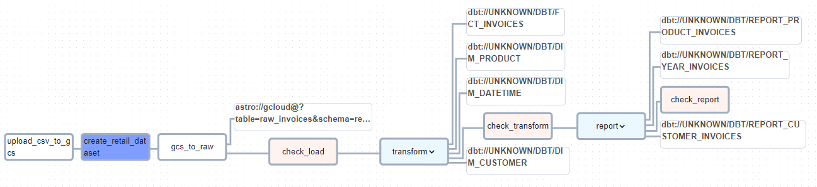
Data Ingestion
Orchestrating Flow (Batch Pipeline)
Proprietary of IYKRA - Data Fellowship

Slide 17

Data Warehouse

Slide 18
Data Ingestion
Transforming Data
Raw Data
dbt
Preprocessed Data
Drop missing values in CustomerID.
Change CustomerID type from STRING to INT.
12345.00 → 12345
Extract InvoiceDate to add columns year, month, quarter, day of week, and week of year.
Change UnitPrice for each StockCode with mode.
Calculate TotalPrice using Quantity * UnitPrice.
Quantity UnitPrice TotalPrice
2 2.5 5.0
Calculate TotalOrders, TotalItems, TotalSales for each CustomerID.
Proprietary of IYKRA - Data Fellowship

Slide 19
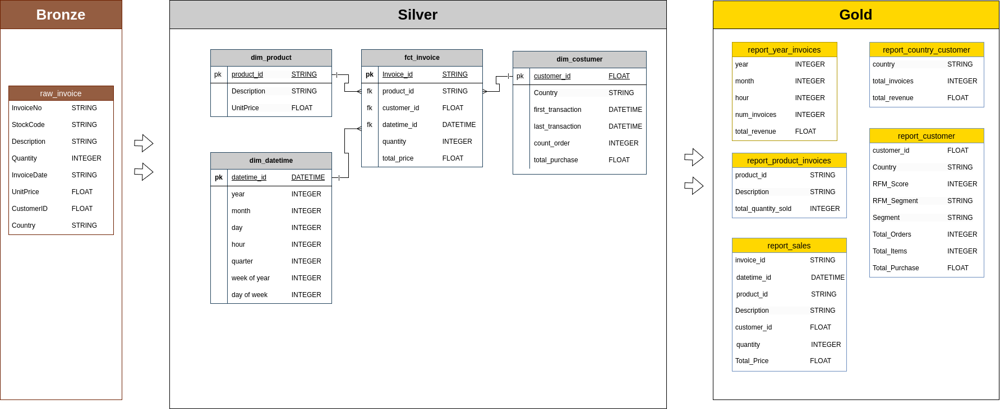
Data Warehouse
Modeling Data Warehouse
Proprietary of IYKRA - Data Fellowship

Slide 20
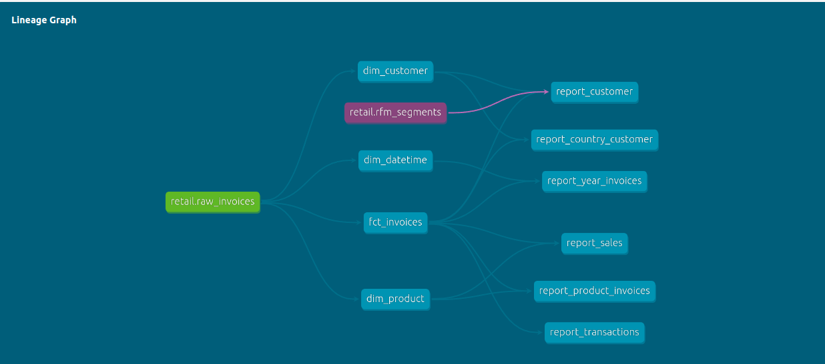
Data Warehouse
Data Lineage
Proprietary of IYKRA - Data Fellowship

Slide 21
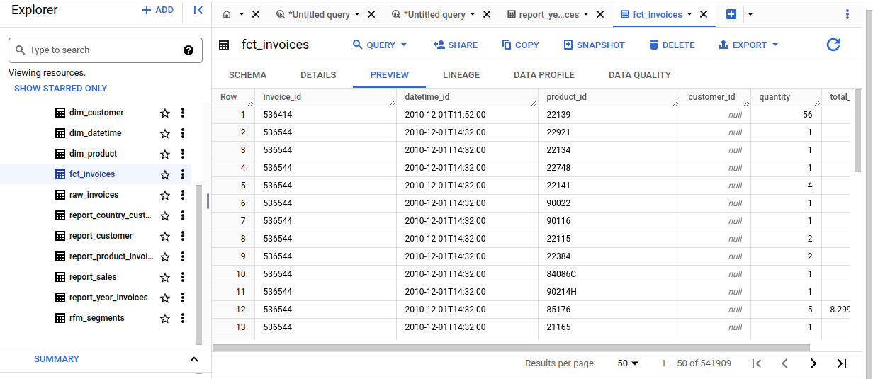
Data Warehouse
Data Warehouse
Proprietary of IYKRA - Data Fellowship

Slide 22

Machine Learning Model

Slide 23
Machine Learning Model
Introduction of Customer Lifetime Value
Customer Lifetime Value (CLV) is the monetary value that represents the amount of income or profit a customer will provide to the company during the relationship period. The comparison between obtaining long-term and short-term clients is illustrated by CLV. The most crucial inquiries regarding sales for any business may be answered with the aid of customer lifetime value, or CLV:
How to Identify the most profitable customers?
How can a company offer the best product and make the most money?
How to segment profitable customers?
Proprietary of IYKRA - Data Fellowship

Slide 24
Machine Learning Model
Steps of CLV Modeling
Take a dataset of customer purchases and divide it into pre- and post- threshold periods; the first 9 months and the 3 last months.
Calculate the R, F, M features in the pre-threshold period, and calculate the Monetary or value in the post-threshold period.
Train a machine learning algorithm on the pre-threshold features, and use it to make predictions about the post-threshold Monetary Value.
https://towardsdatascience.com/from-probabilistic-to-predictive-methods-for-mastering-customer-lifetime-value-72f090ebcde2
Proprietary of IYKRA - Data Fellowship

Slide 25
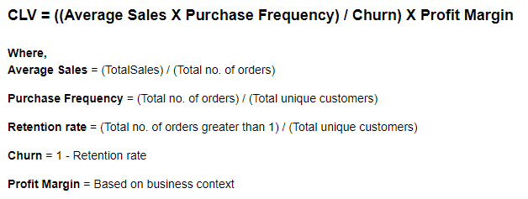
Machine Learning Model
Customer Lifetime Value Prediction
There is the general formula for calculating the Customer Lifetime Value:
Proprietary of IYKRA - Data Fellowship

Slide 26
Machine Learning Model
Customer Lifetime Value and RFM?
RFM analysis is a customer segmentation technique that evaluates which customers are most and least valuable to a company, based on recency, frequency and monetary value.
The next step is to link a description and marketing actions to each segment to improve your relationship with all the customers within the clusters.
By segmenting your customers with RFM, you can also each group individually and determine which set of customers has the highest Customer Lifetime Value (CLV), as we will explain further.
Proprietary of IYKRA - Data Fellowship

Slide 27
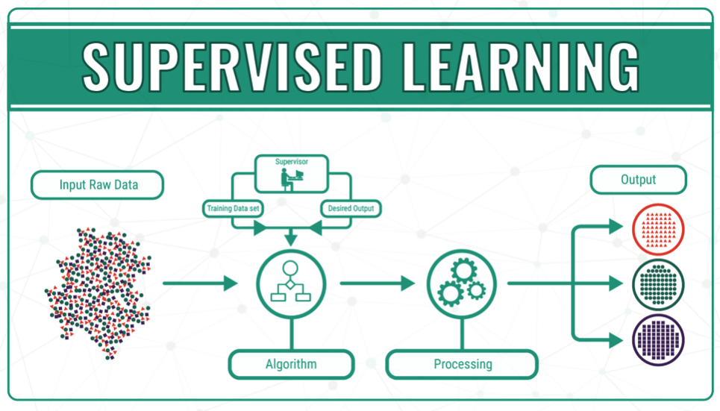
Title
Machine Learning Model
Proprietary of IYKRA - Data Fellowship

Slide 28
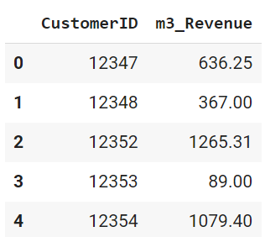
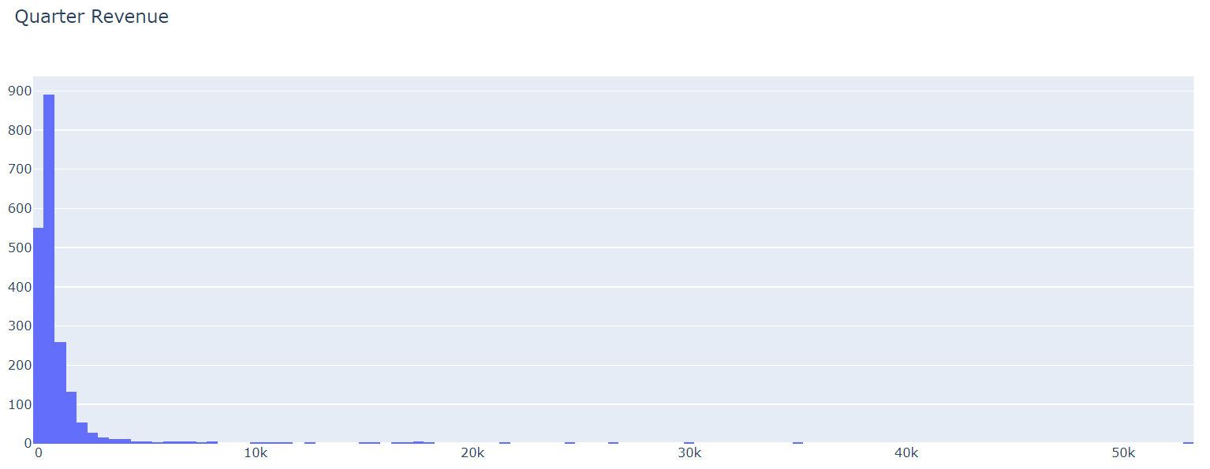
Title
Customer Lifetime Value Prediction
Proprietary of IYKRA - Data Fellowship

Slide 29
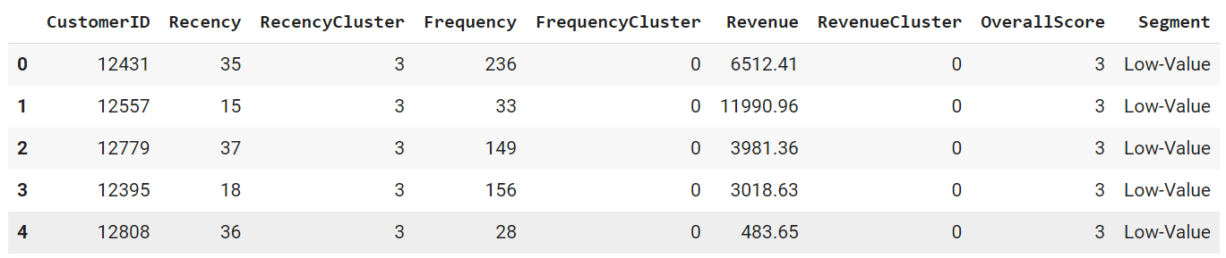
Title
RFM Score on Top 5 Data
Proprietary of IYKRA - Data Fellowship

Slide 30
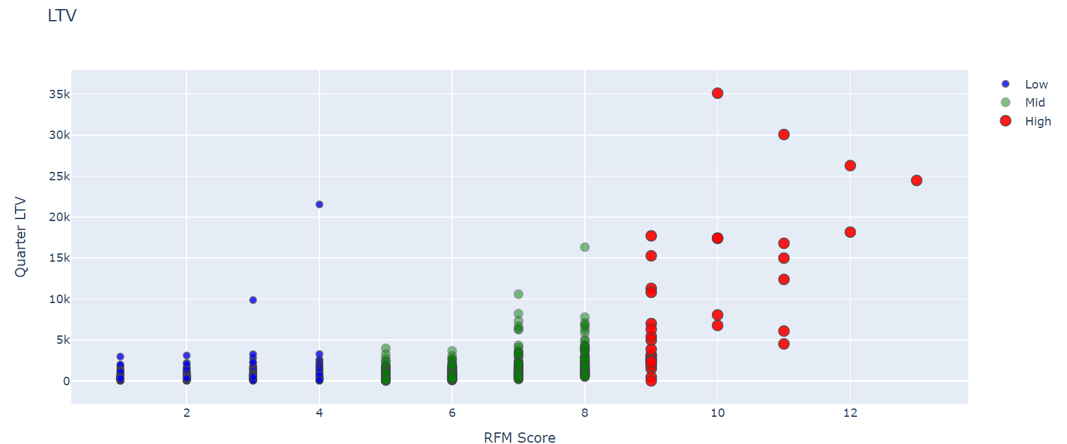
Title
Customer Lifetime Value Prediction
Proprietary of IYKRA - Data Fellowship

Slide 31
Title
Model & Evaluation Machine Learning
Model | Accuracy | Evaluation
 |  | Precision | Recall | f1-score | support
XGBoost | training set: 0.97 test set: 0.89 | 0: 0.94 1: 0.65 2: 0.60 | 0: 0.94 1: 0.62 2: 0.75 | 0: 0.94 1: 0.64 2: 0.67 | 0: 494 1 : 90 2: 8
K-Nearest Neighbors | Train set: 0.894 Test set: 0.865 | 0: 0.91 1: 0.57 2: 0.62 | 0: 0.95 1: 0.43 2: 0.62 | 0: 0.93 1: 0.49 2: 0.62 | 0: 494 1 : 90 2: 8
Logistic Regression | Train set: 0.859 Test set: 0.863 | 0: 0.89 1: 0.58 2: 1.00 | 0: 0.97 1: 0.34 2: 0.38 | 0: 0.93 1: 0.43 2: 0.55 | 0: 494 1 : 90 2: 8
Random Forest | Train set: 1.0 Test set: 0.883 | 0: 0.93 1: 0.64 2: 0.55 | 0: 0.95 1: 0.53 2: 0.75 | 0: 0.94 1: 0.58 2: 0.63 | 0: 494 1 : 90 2: 8
Gradient Boosting | Train set: 0.959 Test set: 0.902 | 0: 0.94 1: 0.70 2: 0.70 | 0: 0.95 1: 0.62 2: 0.88 | 0: 0.95 1: 0.66 2: 0.78 | 0: 494 1 : 90 2: 8
Proprietary of IYKRA - Data Fellowship

Slide 32
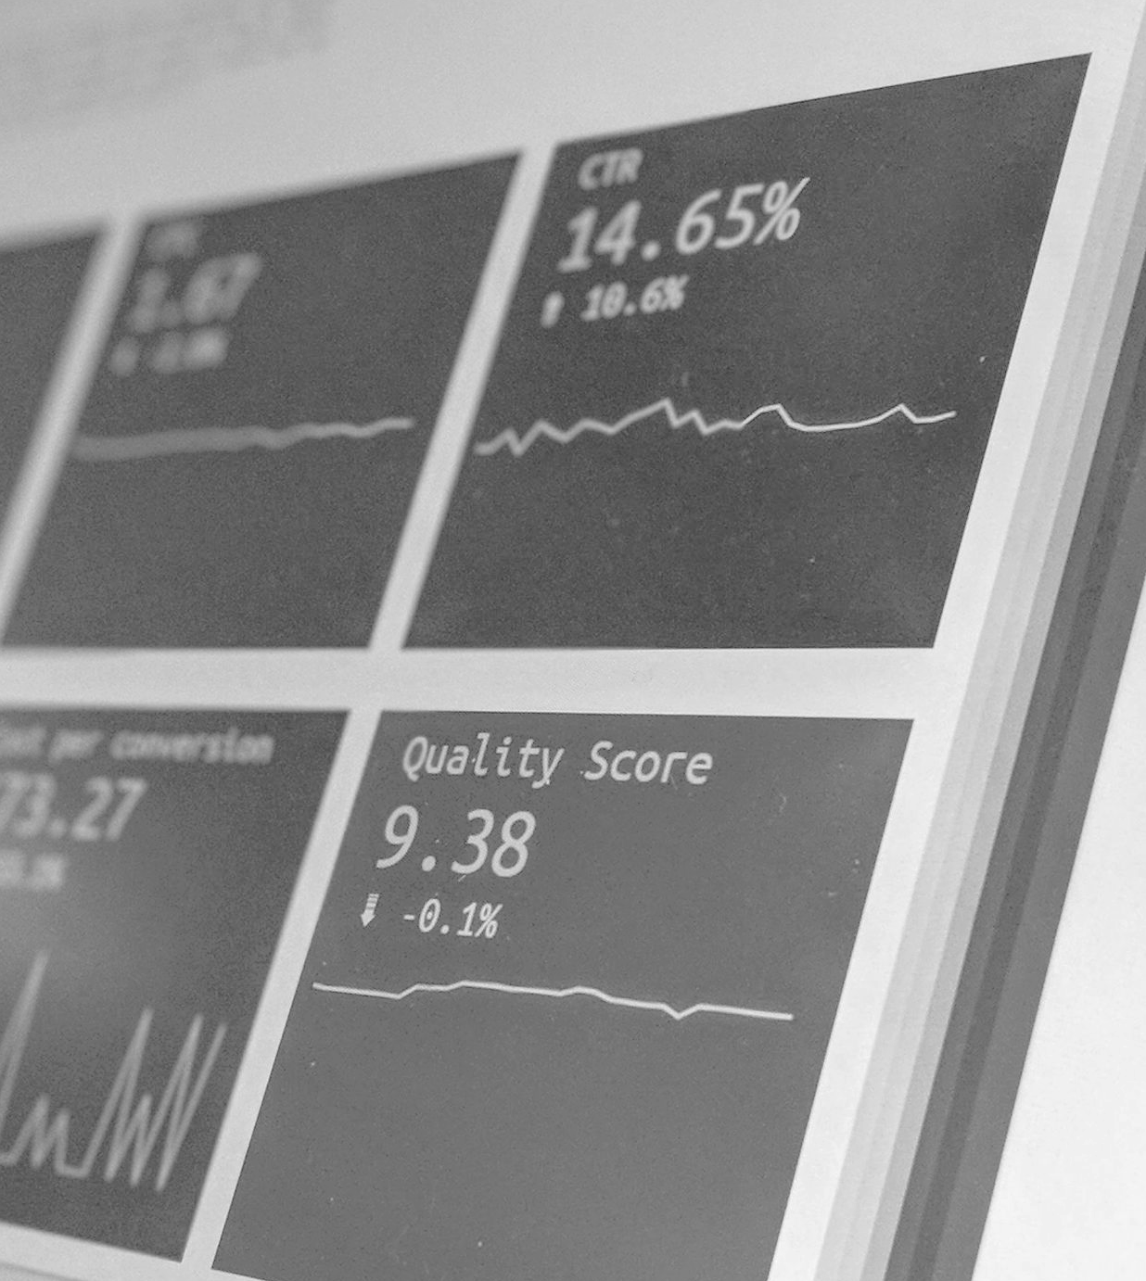
Reporting & Analytics

Slide 33
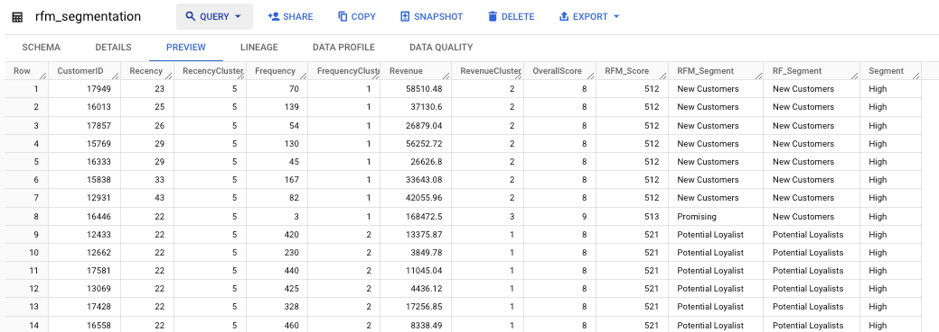
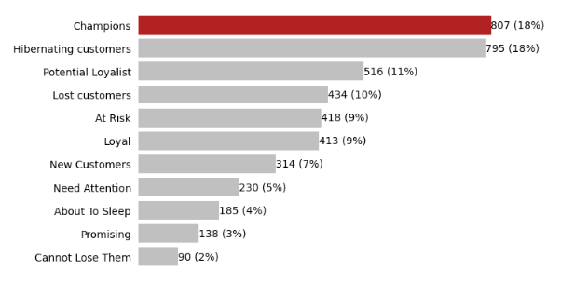
Reporting & Analytics
RFM Segmentation
Customers are segmented into 11 categories based on the R, F, and M score.
Each RFM score was clustered based on Quartile function using 5 quartiles.
For R, the higher the cluster the longer customer didn’t create any order. And for F and M, the higher the cluster, the better the value.
Based on the Monetary (Revenue) itself, customers also segmented into Low/Mid/High value.
Proprietary of IYKRA - Data Fellowship

Slide 34
Reporting & Analytics
CLV Prediction
Proprietary of IYKRA - Data Fellowship

Slide 35
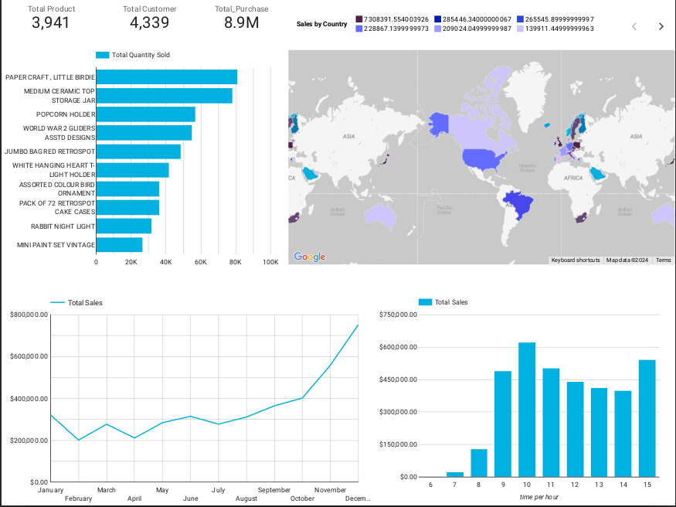
Sales Dashboard
Current CLV Dashboard
*will be improved
Proprietary of IYKRA - Data Fellowship

Slide 36
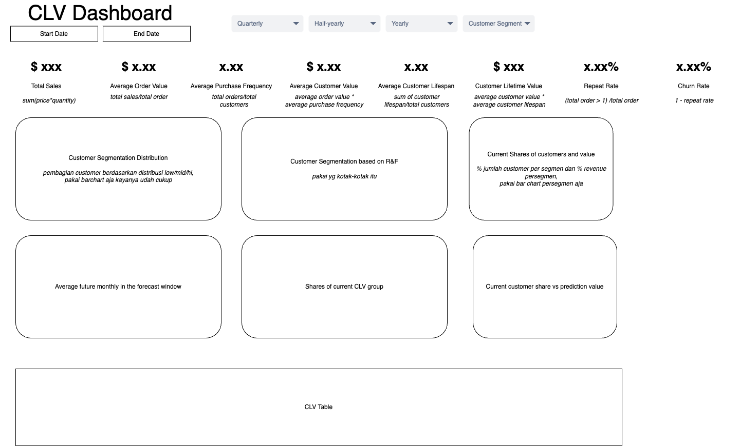
Reporting & Analytics
Mockup Dashboard
Proprietary of IYKRA - Data Fellowship

Slide 37
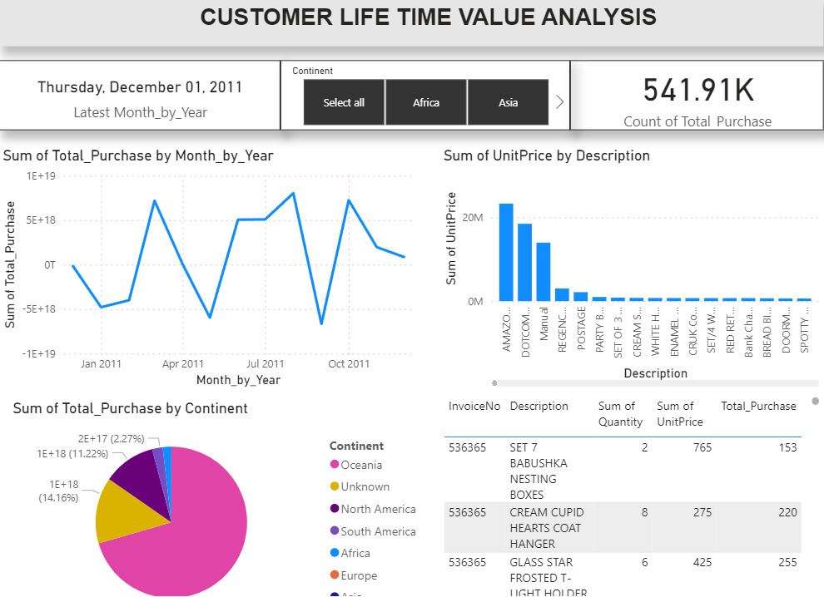
Title
Proprietary of IYKRA - Data Fellowship *Ilustrasi Sementara

Slide 38
Any representative picture
Conclusion & Improvement

Slide 39
Conclusion & Improvement
CLV
Proprietary of IYKRA - Data Fellowship

Slide 40
Conclusion & Improvement
Reporting Dashboard
Proprietary of IYKRA - Data Fellowship

Slide 41
Conclusion & Improvement
Analytics
Proprietary of IYKRA - Data Fellowship

Slide 42
Any representative picture
Reproducibility

Slide 43
Title
Conclusion and Improvement
Proprietary of IYKRA - Data Fellowship

Slide 44
Title
Business Improvement
Proprietary of IYKRA - Data Fellowship

Slide 45
Thank you!
Or you can insert quotes :D

